Slide 1
The Missing Semester of your CS Education
The Linux Terminal

Slide 2

What Is Linux?
A family of open-source operating systems, based off the Linux/Unix kernel
Built with a philosophy of openness and modularity
Differs from Windows in that it is based off a unix kernel

Slide 3

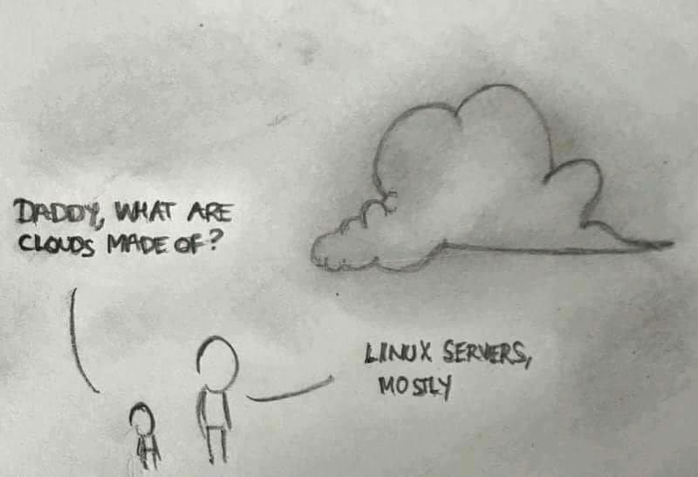
Why do we want to use it?
The code you write will likely end up on a Linux server somewhere
Customizability
Ease of troubleshooting
Everything can be done through the terminal

Slide 4
Linux Comes in Many Flavors
Several common Linux distros:
Ubuntu
Debian
Redhat
Arch

Slide 5

Distros? I thought Linux Was the Operating system!
Linux is not the operating system; it is the kernel
A distribution (Distro) is the actual operating system
The defacto for newer users is Ubuntu

Slide 6

Windows Subsystem for Linux
Allows running of a Linux kernel from within windows
Emulates Windows file system calls in a way that the Linux kernel can understand
Not really a fully Virtual Machine, but an incredible tool none the less

Slide 7
Windows Subsystem for Linux Cont.
Provides the ability to interact with a Linux environment from within the comfort of your Windows OS
Supports running Linux GUI apps from within Windows in newer version
Docker requires WSL for peak performance on Windows

Slide 8
Bash
“Born Again Shell”
An improved version of SH, now the default on most Distros, as well as the default in MacOS
Serves as a command language interpreter for the OS
What we commonly see, and think of as a “terminal” in a Linux environment

Slide 9
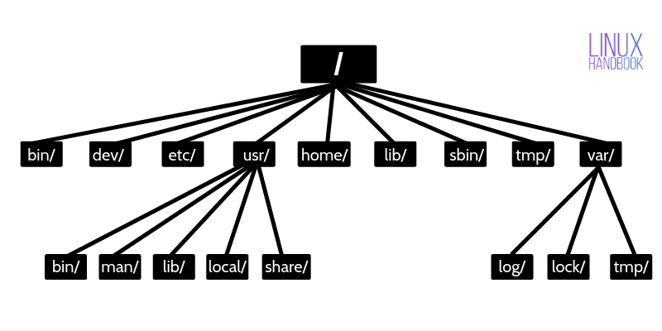
The Linux File Structure
/ - The root directory of the whole computer
/bin – essential binaries for all users
/dev – Essential device files
/etc – Host specific system wide settings
/ home user’s home directories
/lib – libraries for essential binaries
/sbin – contains system essential binaries
/tmp – temporary files
/usr – contains the majority of mutli user programs, most software installed here

Slide 10
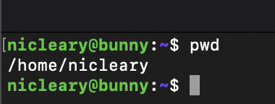
pwd
Print out the path you are currently located in, starting at root directory
Useful for finding “where” you are in the file structure

Slide 11
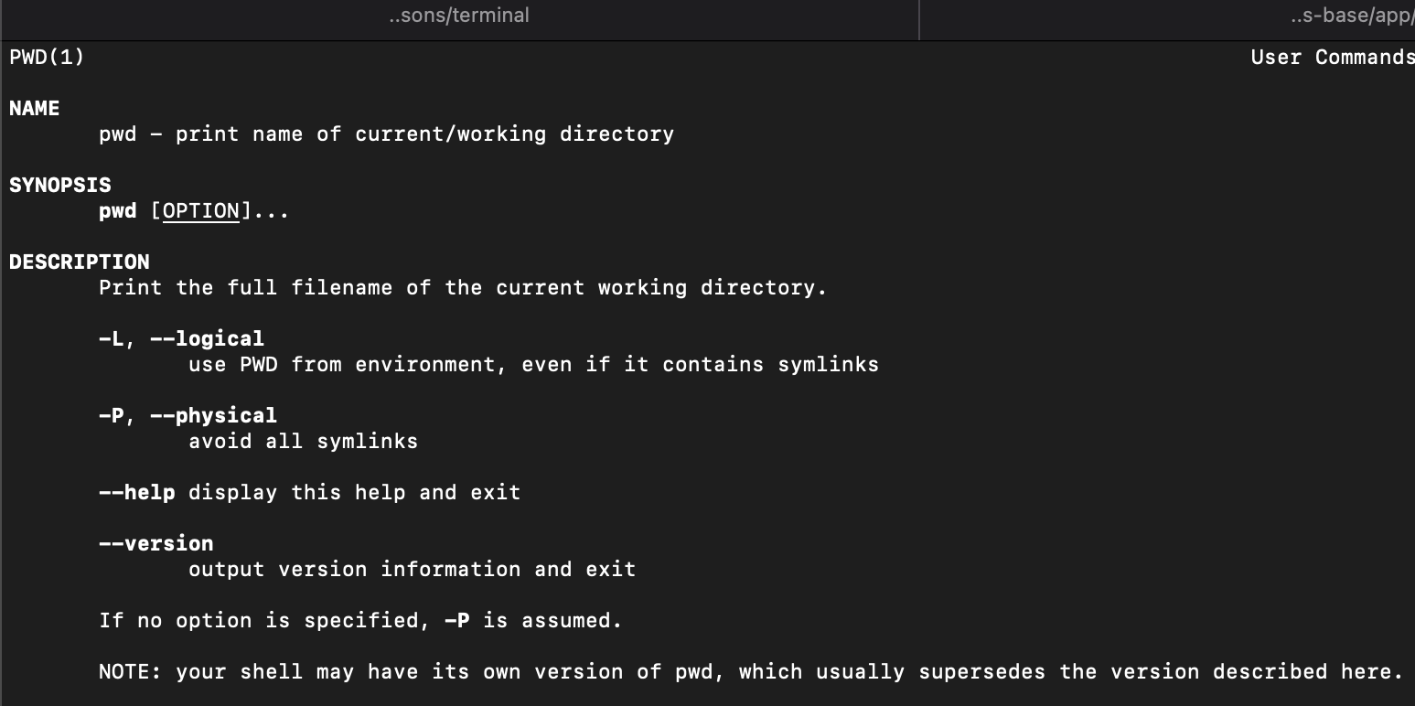
man
Provides a helpful manual for any Linux command
A great place to reference if you don’t know the possible options for a command, or understand what it does

Slide 12
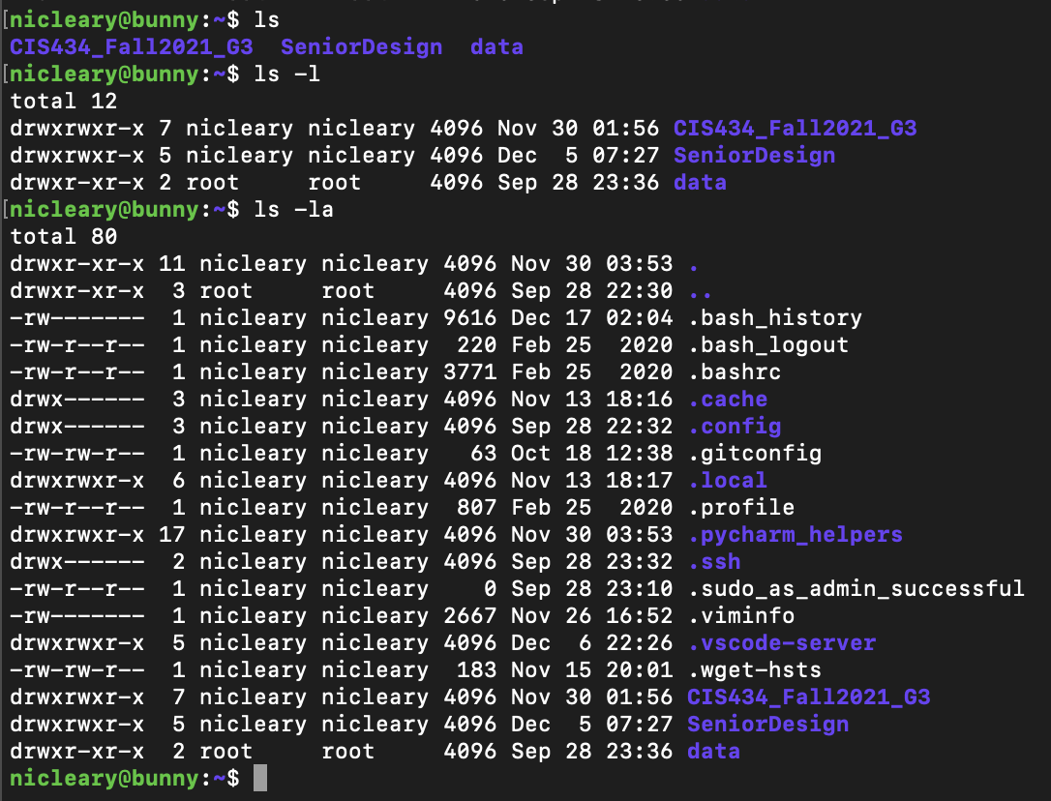
ls
Display a list of files/folders in the current directory
Use –l flag to display detailed information about the current directory
Use –a to show hidden files/folders (those whose name starts with a “.”)

Slide 13
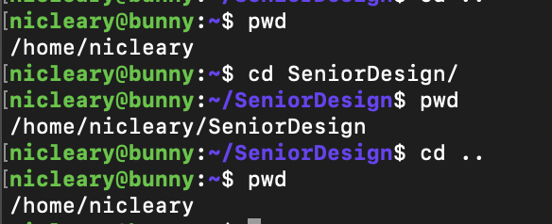
cd
Changes your current directory
cd .. Changes your directory to the parent directory
cd ~ changes to your home directory

Slide 14
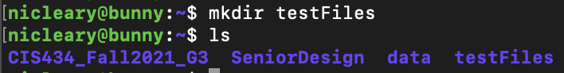
mkdir
Create a new directory

Slide 15
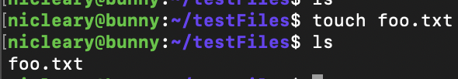
touch
Create a file with the specified name

Slide 16
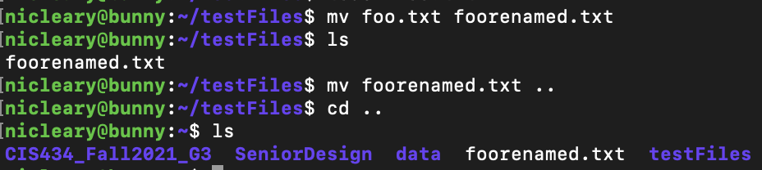
mv
Move files to a different location
Rename files

Slide 17
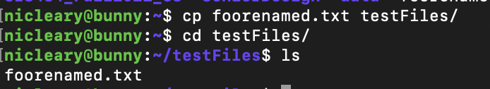
cp
Copies files
Specify –r to recursively copy files (copy all files in a directory and its subdirectories)

Slide 18
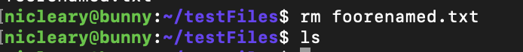
rm
Remove a file
Use rm –r to remove a non-empty directory
Be careful with this—there’s no “recycle bin” with the rm command

Slide 19
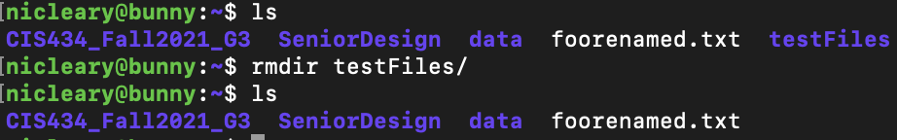
rmdir
Remove an empty directory

Slide 20
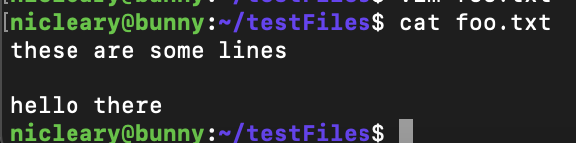
cat
See the contents of a file

Slide 21
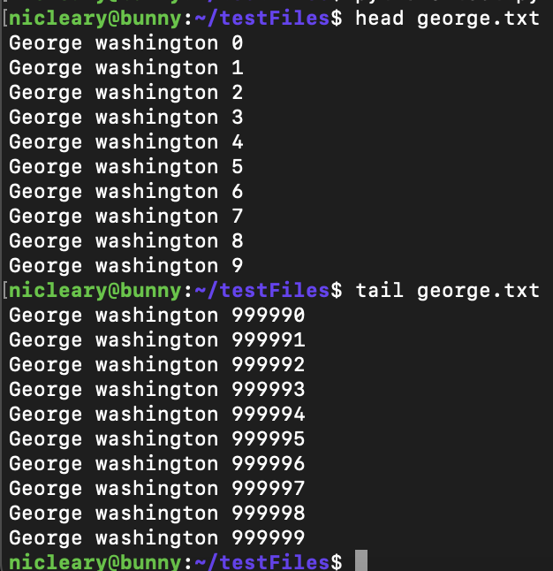
head and tail
Head: see the first 10 lines of a file
Tail: see the last 10 lines of a file

Slide 22
grep
Search for a string in a file
Can also be used to recursively search directories

Slide 23
Pipes
Take the output from one command, and use it as the input as the next
In this example, use the “wc” (word count) command in conjunction with grep to find out how many times the word ”washington” is in the george.txt file

Slide 24
find
Search for a file in a specified directory and its subdirectories

Slide 25
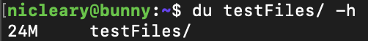
du
See the disk usage of a specified file or directory
Use –h to see in MBs/KBs/GBs instead of blocks

Slide 26
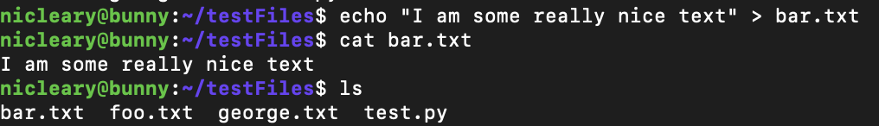
echo and I/O redirection
echo: print specified string in the terminal
Output redirection: use the “>” symbol to take the output of any command and write it to a file
Input redirection: use the “<“ symbol to take the contents of a file, and use it as the input for a command

Slide 27
sudo
“Super User do”
Like running a command/program as an administrator in Windows
Commonly used to install programs, as seen in next slide
Running a command with sudo runs it as the root user (the most powerful user) on the system; use it with caution

Slide 28
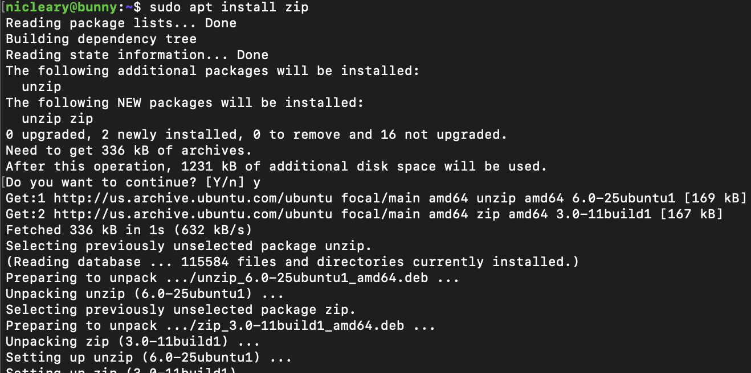
Package Managers
A way to download “packages” (programs) through the command line
A simple one-line command to install many common packages
apt is the package manager used by Ubuntu

Slide 29

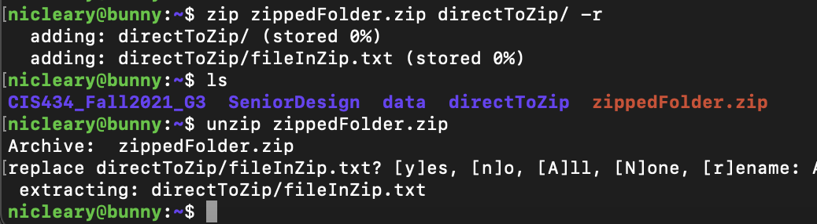
zip and unzip
zip to compress files, unzip to decompress

Slide 30
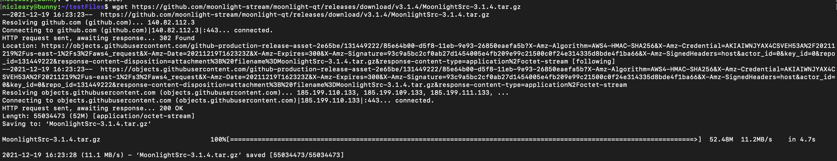
wget
Download a file from the internet
Notes:
https://github.com/moonlight-stream/moonlight-qt/releases/download/v3.1.4/MoonlightSrc-3.1.4.tar.gz

Slide 31
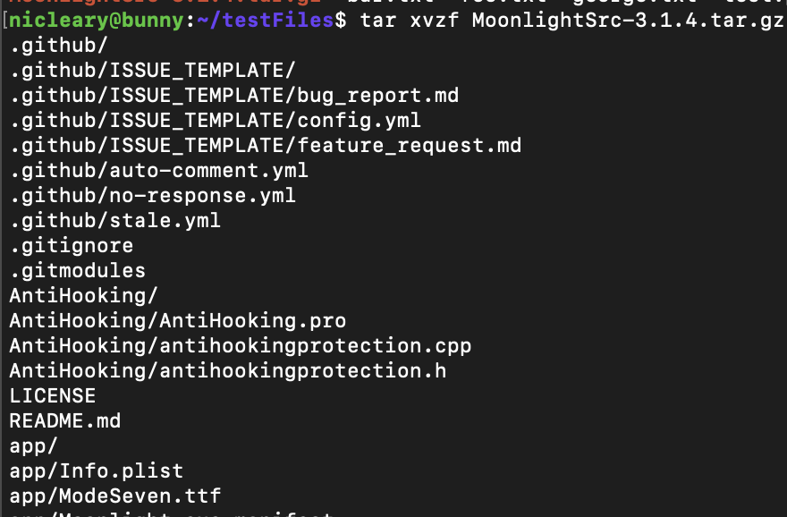
tar
Extract a file (similar to unzip)
.tar is a common Linux format.
Typically, to extract a tarball, use xvzf flags

Slide 32
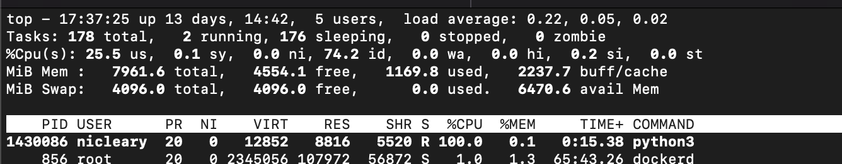
top
Task manager, but in your terminal
Shows vital information about running processes on the computer, including the Process ID
Use Control+C to exit

Slide 33
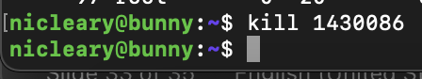
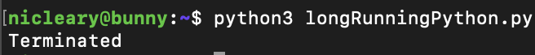
kill
Kill a process by passing in it’s Process ID (found using top)

Slide 34
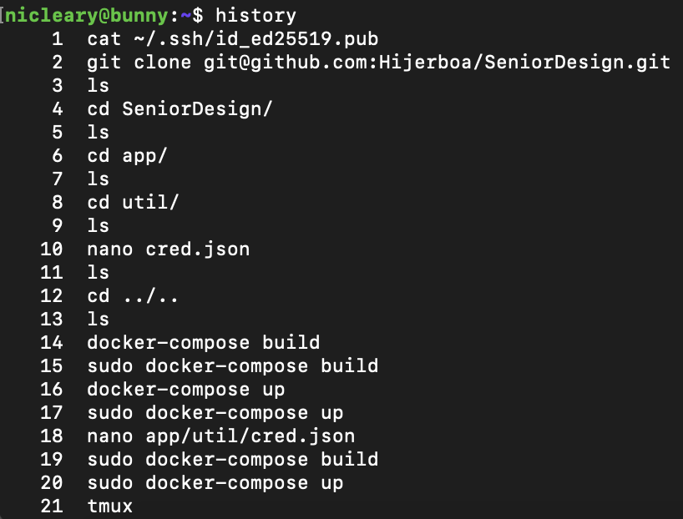
history
See your past command history
Useful for knowing what you did on a system

Slide 35
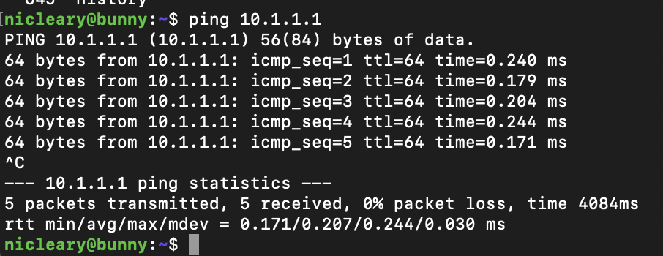
ping
Send network packets to check if another system on the network is “alive”
Operates similarly, but not identically to Windows command
Continues to send packets until it is stopped, by default

Slide 36
Permissions and File Ownership
chmod to change file/folder permissions
Specify owner, group, and everyone privileges for read, write, and execute
chown to change file/folder permissions

Slide 37
Editing Text In the Terminal
Nano: Relatively simple and easy to use text editor, installed by default on almost every machine. Uses “standard” shortcuts for keyboard navigation
VIM: Has a much steeper learning curve than nano. Used by a wide community of developers who have build their workflow around it, and many say that once you get past the initial learning curve, it is the fastest method of text editing

Slide 38
SSH: Secure Shell
Allows for remote access to another machine’s terminal, connected over the internet
When SSH’d into another machine, you can run commands and navigate the command line as if you were sitting in front of the terminal
Incredibly useful for interacting with ”headless” machines, and a vital necessity in Linux system administration

